Slide 1
Agentic AI Health Symptom Checker
CAPSTONE PROJECT
Presented By:
JAHNAVI PENMETHSA
St. Martin’s Engineering College
Computer Science and Engineering (AI & ML)

Slide 2
OUTLINE
Problem Statement
Proposed System/Solution
System Development Approach
Algorithm & Deployment
Result
Conclusion
Future Scope
References

Slide 3
Problem Statement
With the rapid adoption of AI in healthcare, there is a growing need for accessible, accurate, and reliable health information systems that empower individuals to make informed decisions without promoting self-diagnosis. Millions of people, especially in rural and underserved areas, lack immediate access to healthcare professionals and often rely on unverified online sources, leading to misinformation and delayed treatment.
The challenge is to develop an Agentic AI Health Symptom Checker using IBM Cloud Lite and IBM Granite LLM with a RAG pipeline to provide safe, multilingual, and verified health guidance, promoting early awareness and timely medical consultation.

Slide 4
Proposed Solution
The proposed system is an Agentic AI Health Symptom Checker that allows users to describe their symptoms in natural language and receive educational, non-diagnostic health information.
It uses RAG (Retrieval-Augmented Generation) to fetch trusted content from WHO, Government Health Portals, and verified medical databases.
Supports multilingual conversations for inclusivity.
Provides:
Probable conditions (with disclaimers)
Preventive advice
Urgency level
When to consult a doctor
Home remedies (if applicable)
Powered by IBM Granite LLM for natural conversation.
Hosted and deployed on IBM Cloud Lite Services for free-tier accessibility.

Slide 5
System Approach
System Requirements
a. Hardware Requirements
Processor: Intel i5/i7 or AMD equivalent
RAM: Minimum 8 GB (Recommended 16 GB)
Storage: 20 GB free space
b. Software Requirements
Operating System: Windows 10/11, macOS, or Linux
IBM Cloud Lite Account with access to:
IBM Granite LLM
IBM Watson Discovery
IBM Watson Assistant
IBM Cloud Object Storage
Web Browser: Chrome / Edge / Firefox

Slide 6
System Approach
Libraries / Tools Required
Watson Discovery
Used for RAG (Retrieval-Augmented Generation) by ingesting verified health documents.
Provides search and retrieval capabilities via natural language queries.
Watson Assistant
Creates the conversational interface (chatbot) for users.
Manages intents, entities, and dialog flows.
IBM Granite LLM
Generates contextual and natural-sounding responses.
Works with retrieved data to provide safe educational guidance.
Cloud Object Storage
Stores source documents and datasets.
Used by Watson Discovery for ingestion.
Language Translator Service (Optional)
Adds multilingual support to handle queries in multiple languages.

Slide 7
Algorithm & Deployment
Algorithm Steps:
Input Acquisition – User describes symptoms via chatbot interface.
Language Processing – Detect language → Translate to English if required.
Information Retrieval (RAG)
Query sent to IBM Watson Discovery with vector similarity search.
Retrieve relevant documents from WHO / government health portals.
LLM Processing (Granite)
Retrieved context is fed to Granite for summarization and generation.
Ensure medical disclaimers are appended automatically.
Urgency Detection – Simple symptom severity scoring using predefined rules (e.g., high fever + chest pain = urgent).
Output Generation – Conditions, preventive advice, home remedies, referral recommendations.
Output Delivery – Return to frontend in multilingual format.

Slide 8
Algorithm & Deployment
Deployment Steps
Create Watson Discovery instance → upload verified datasets.
Create Watson Assistant → integrate with Granite API.
Host Flask backend on IBM Cloud Code Engine.
Serve frontend from IBM Cloud Object Storage (Static Website).
Connect Watson Assistant to frontend via WebSocket or REST API.

Slide 9
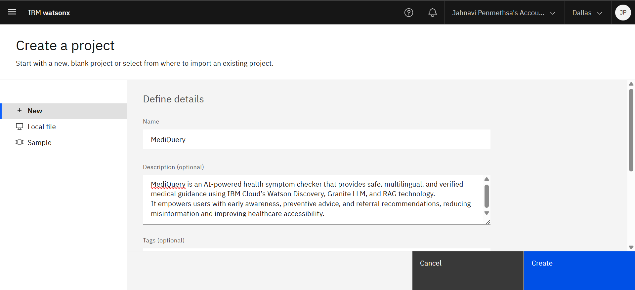
Result
Project Definition and Overview Introduces the project title “MediQuery” and outlines its purpose, scope, and objectives

Slide 10
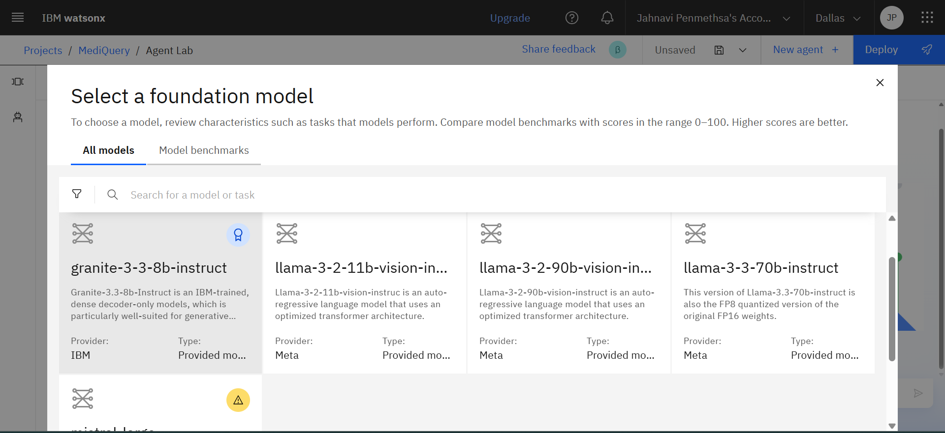
Result
Foundation Model Selection Selection of IBM Granite model granite-3-3-8b-instruct to power the conversational AI capabilities

Slide 11
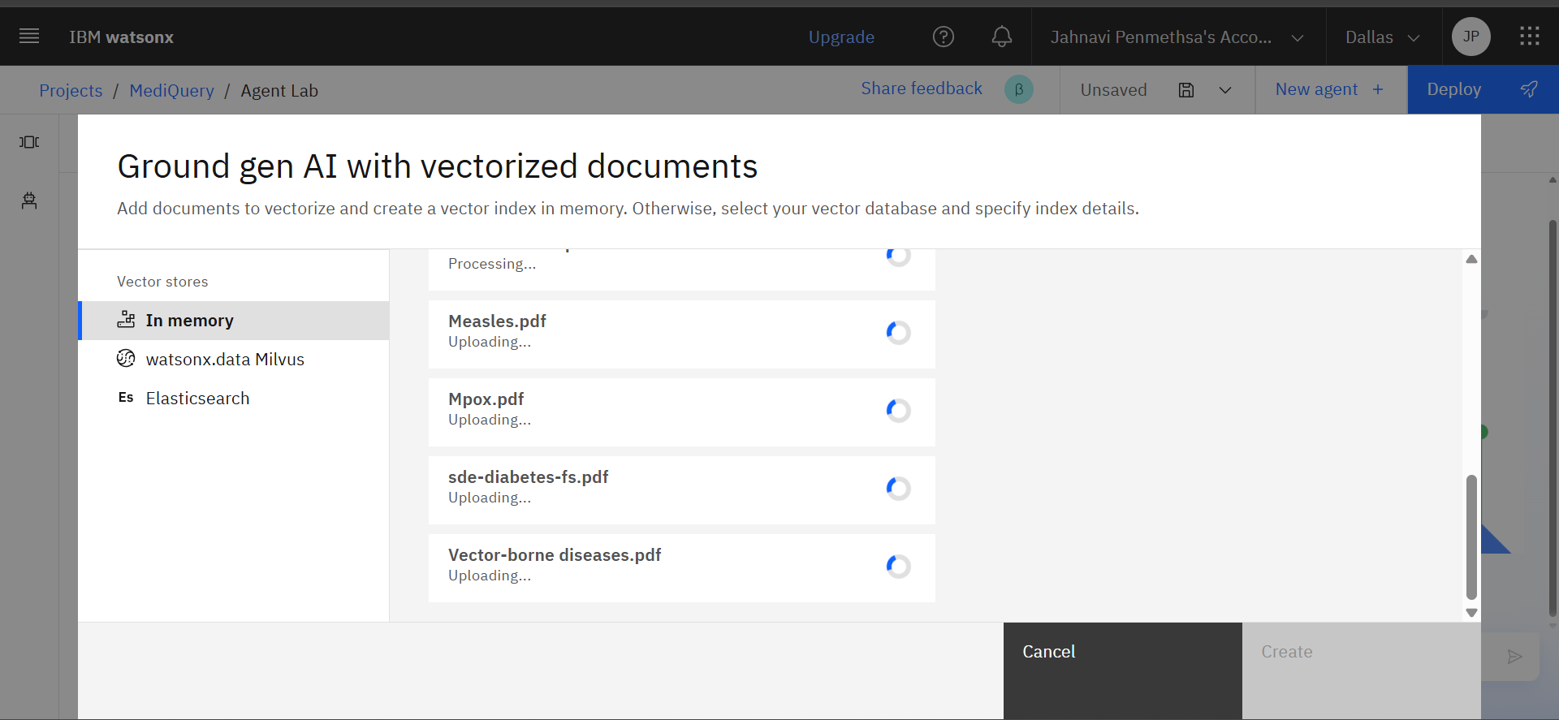
Result
Knowledge Base Preparation Uploading verified WHO and government health documents to enable Retrieval-Augmented Generation

Slide 12
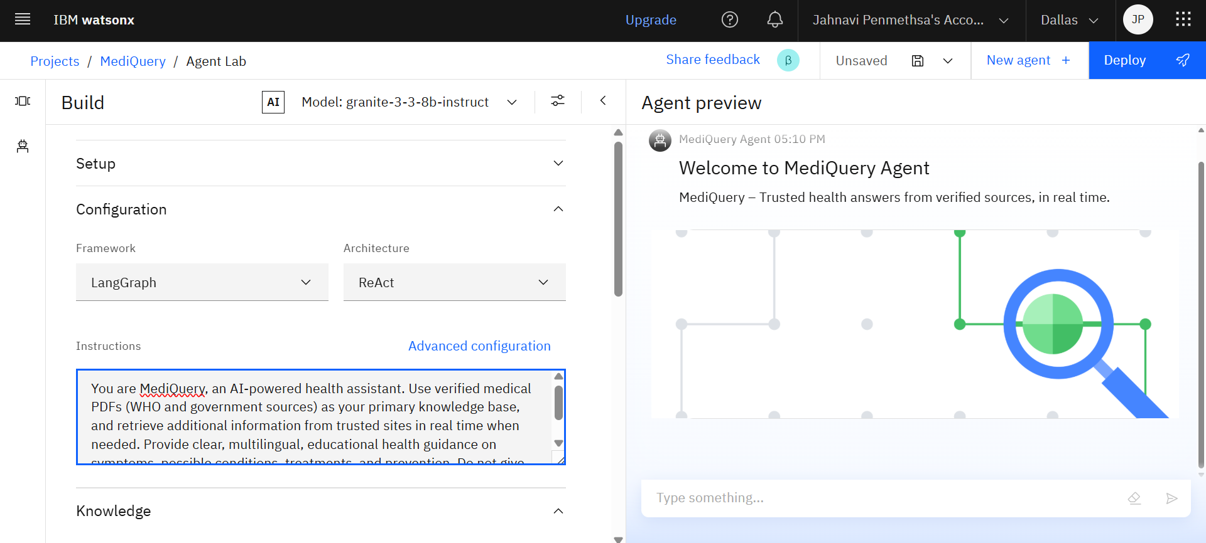
Result
Agent Configuration Defining operational instructions for the MediQuery agent to ensure accurate, and educational responses

Slide 13
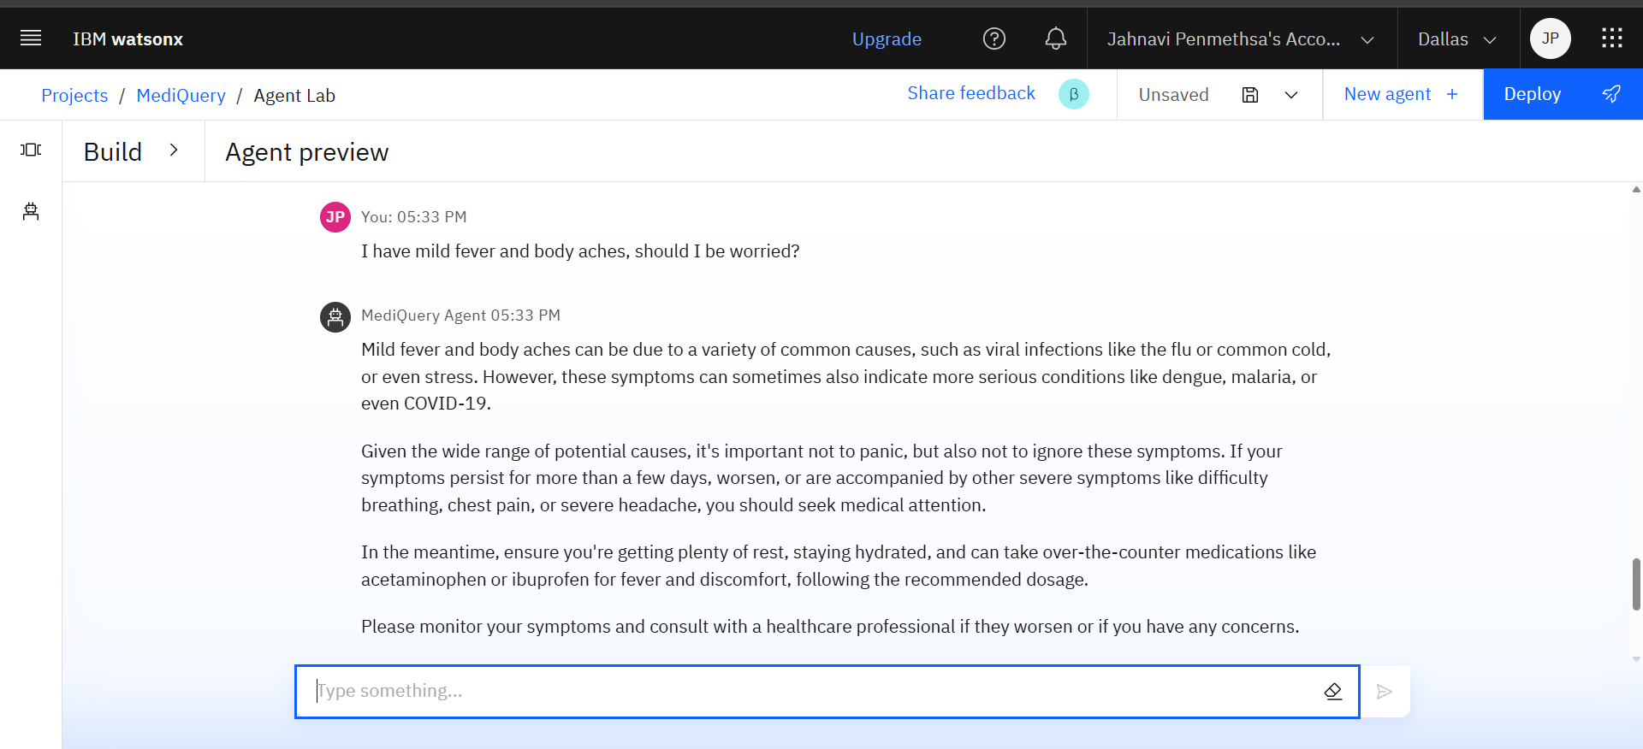
Result
Initial Agent Testing Evaluating the agent’s basic performance by providing a sample health-related prompt

Slide 14
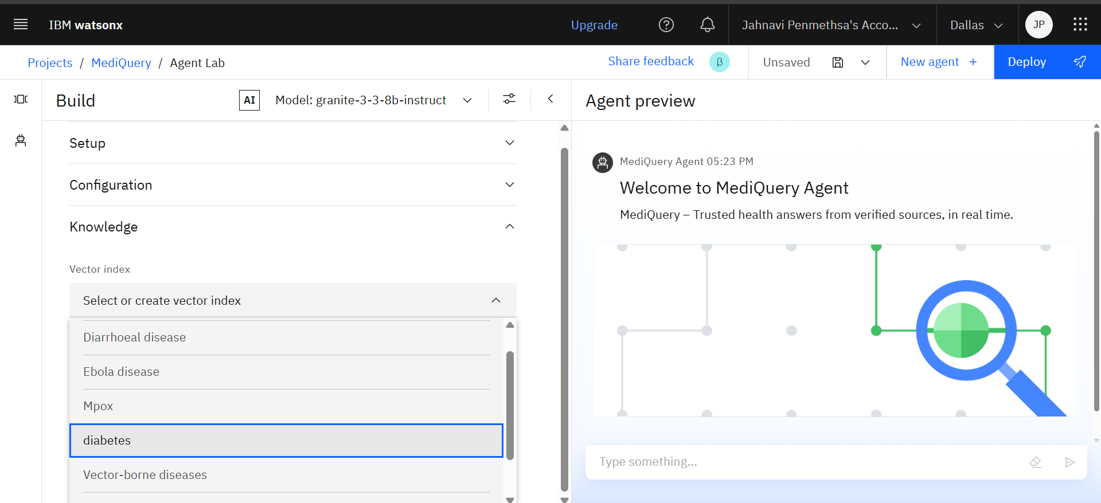
Result
RAG Implementation Integrating RAG by linking one of the uploaded documents from the vector index for contextual retrieval

Slide 15
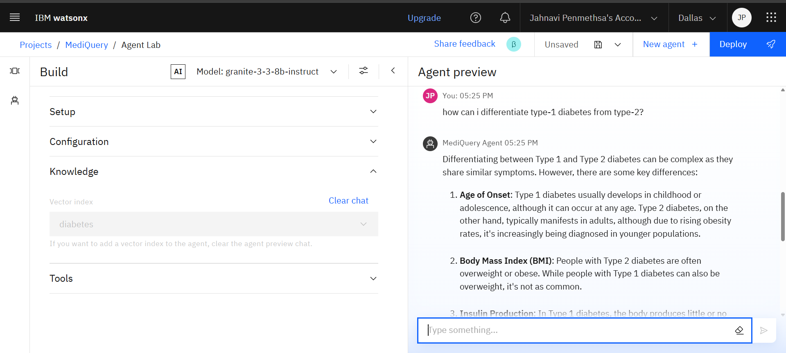
Result
RAG Query Testing Assessing the RAG pipeline’s effectiveness by submitting a test query and reviewing the retrieved context

Slide 16
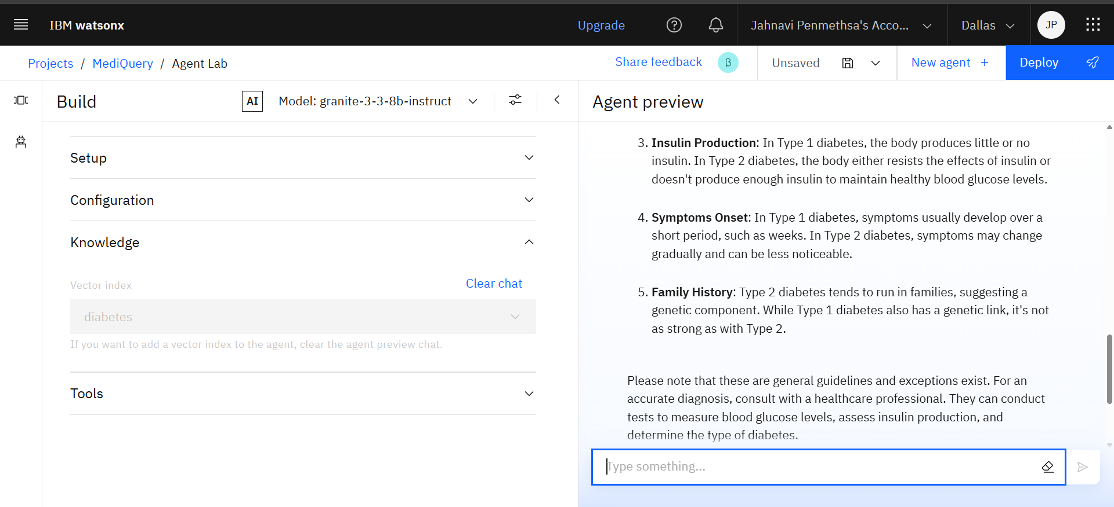
Result
RAG Query Testing Assessing the RAG pipeline’s effectiveness by submitting a test query and reviewing the retrieved context

Slide 17
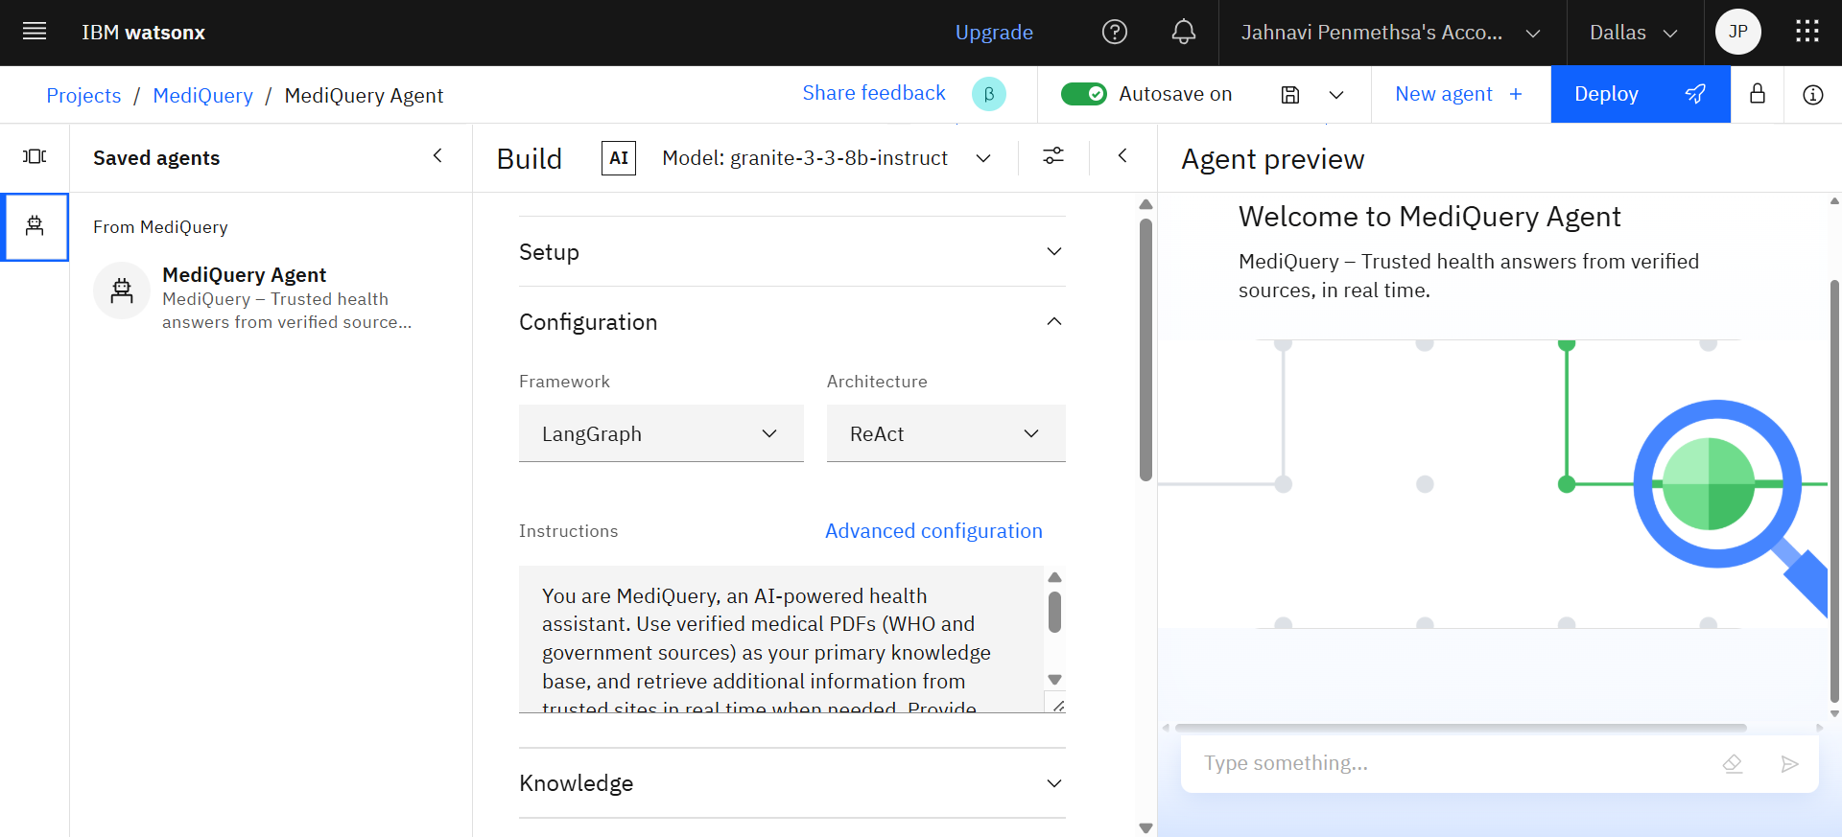
Result
Agent Deployment Saving and finalizing the MediQuery agent for continued use and future enhancements

Slide 18
Conclusion
The Agentic AI Health Symptom Checker demonstrates how AI + RAG can make reliable health education accessible to all.
By retrieving knowledge from verified medical sources, the system promotes early awareness, reduces the spread of misinformation, and enhances accessibility for users across diverse backgrounds.
While challenges such as maintaining accuracy in multilingual responses and ensuring strict adherence to credible sources were encountered, the solution proves effective in bridging the healthcare information gap.
With future enhancements like voice-enabled interaction, offline functionality, and integration with wearable devices, the system holds strong potential to further empower communities with timely and trustworthy health guidance.

Slide 19
Future scope
Integration with wearable devices (Fitbit, Apple Watch) for real-time symptom monitoring.
Expansion to include mental health awareness modules.
Voice-based interaction for low-literacy populations.
Offline mobile app for rural areas with limited internet.
Integration with telemedicine platforms for direct doctor consultation.
AI-powered risk prediction models using medical history.

Slide 20
References
World Health Organization (WHO) – Fact Sheets on Diseases and Conditions
https://www.who.int/news-room/fact-sheets
Indian Council of Medical Research (ICMR) – Public Health Information
https://www.icmr.gov.in
IBM Granite LLM Documentation
https://www.ibm.com/granite
IBM Watson Discovery Documentation
https://cloud.ibm.com/docs/discovery

Slide 21
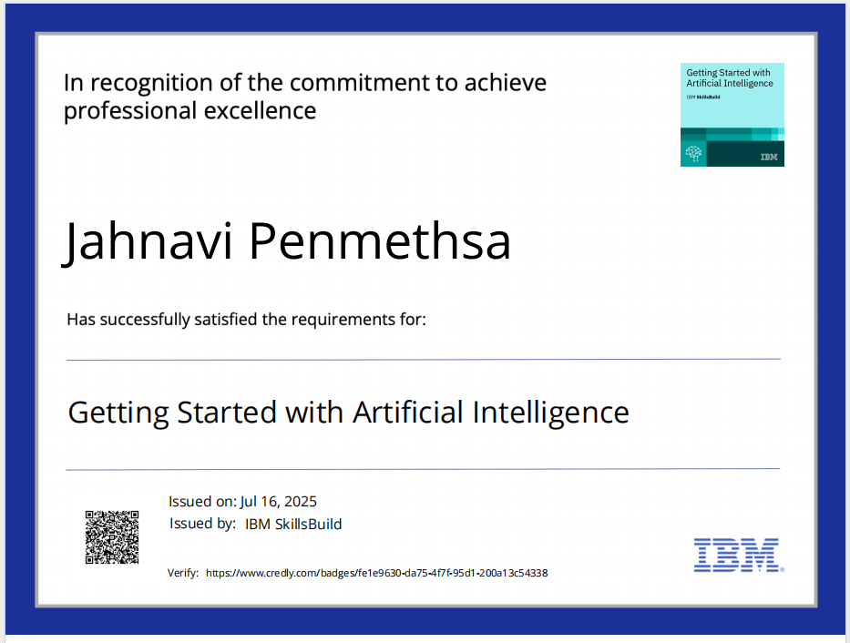
IBM Certifications

Slide 22
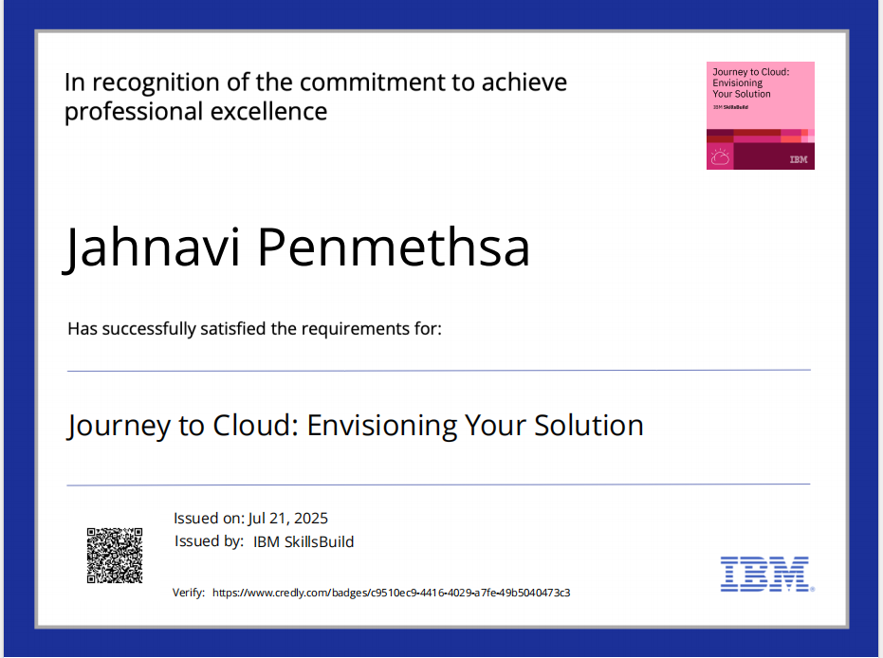
IBM Certifications

Slide 23
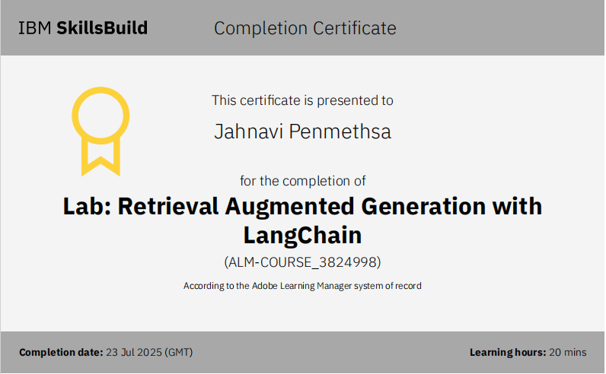
IBM Certifications

Slide 24
THANK YOU

